Slide 1
© Templateswise.com
Optimized U-Net for Brain
Tumor Segmentation
Paper Review by Karishma Kuria
Student Id: 015947191

Slide 2
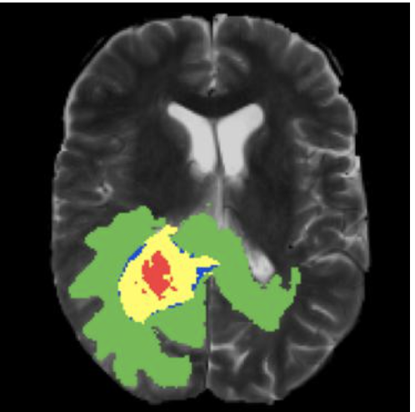
Introduction
In the field of Medical Image Processing, automatic brain tumor segmentation is one of the most strenuous problem.
Gliomas which is one of the most common type of tumor in humans is very challenging to diagnose and treat with only human efforts.
It becomes very challenging to scan it and provide explicit segmentation.

Slide 3

How Deep Learning can help?
In the recent years there has been a great development in the Deep Learning Algorithms.
Convolutional Neural networks has become state-of-the-art for medical image segmentation.
U-Net and Fully Convolutional networks are the commonly used architectures.
Applications includes anatomical segmentation of cardiac CT, detection of lung nodules in chest CT etc.

Slide 4
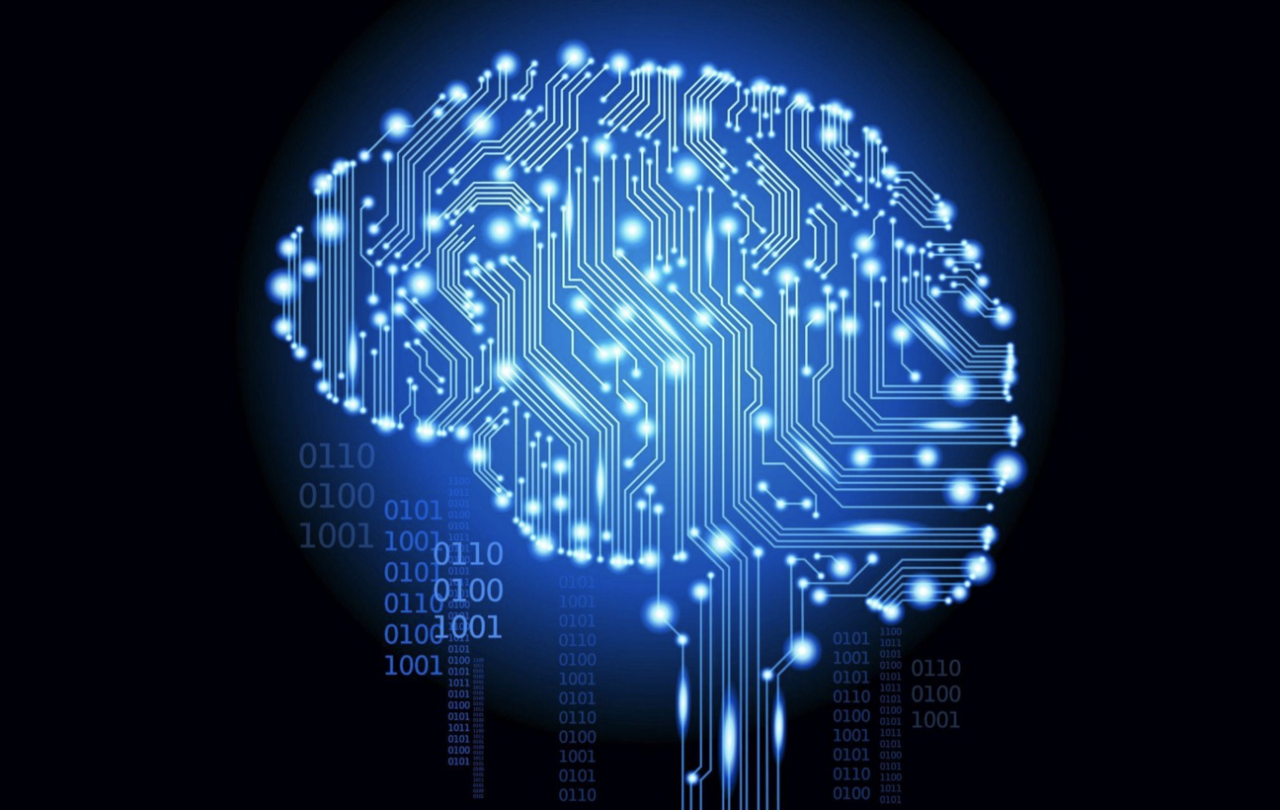
Data Set
1, 251 brain MRI scans including segmentation annotations of tumorous regions.
The 3D volumes with dimensions of (240, 240, 155) voxels.
Annotation consists of 4 classes: peritumoral edematous tissue (ED), necrotic tumor core (NCR), enhancing tumor (ET), and background (voxels that are not part of the tumor).
Four modularity are given for every example: native (T1), post-contrast T1-weighted (T1Gd), T2-weighted (T2), and T2 Fluid Attenuated Inversion Recovery (T2-FLAIR).

Slide 5
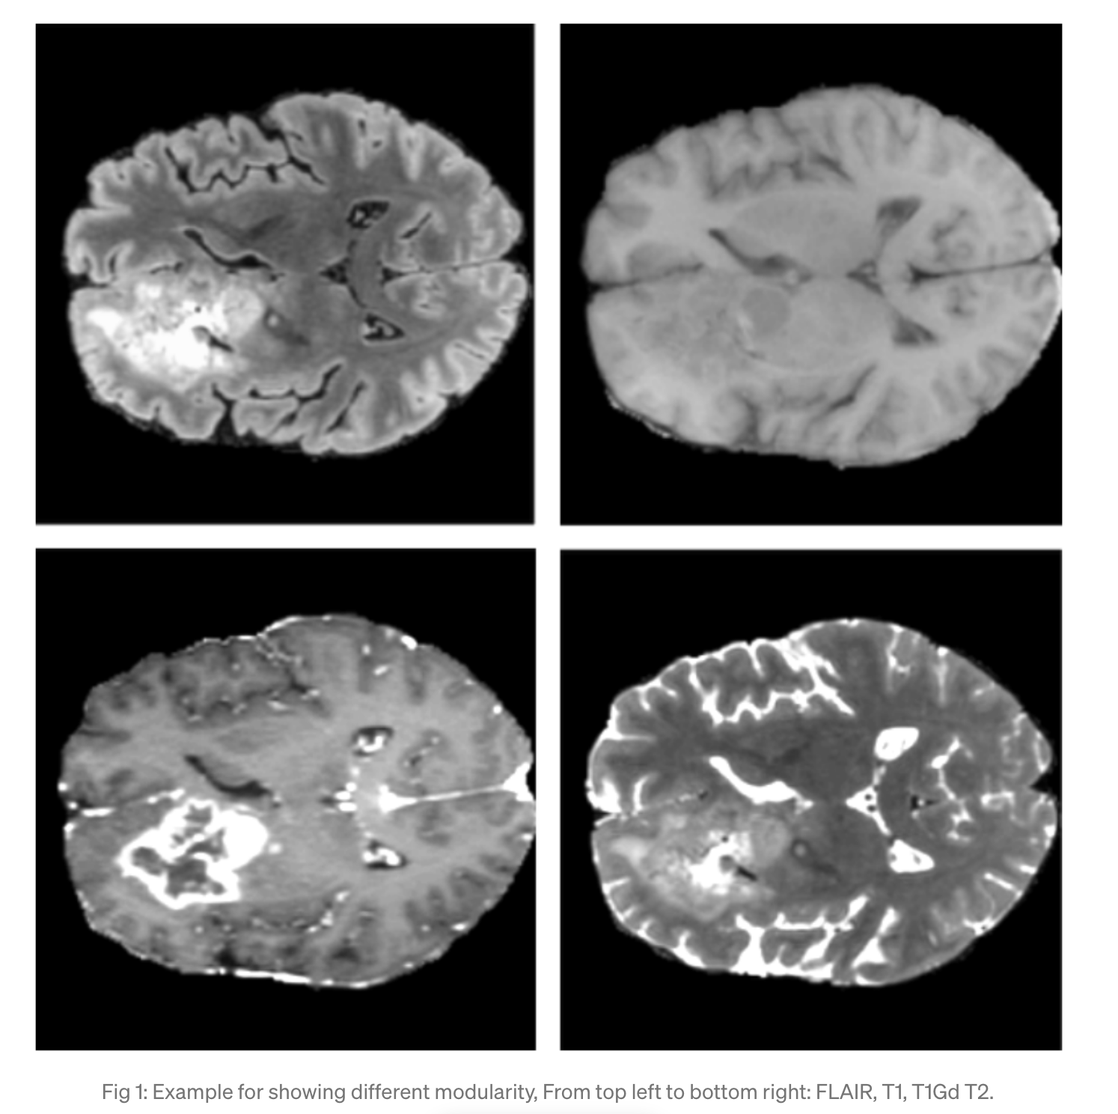
Data Preprocessing
All 4 modularities are stacked. Each example input tensor is in layout (C, H, W, D) and has shape(4, 240, 240, 155). Here H-height, W-width, C-channels and D-depth.
Redundant non important voxels were cropped.
Mean and Standard deviation was taken to normalize all volumes.
Additional input channel created to distinguish between background voxels and normalized voxels using one-hot encoding for foreground voxels and put together with the input data

Slide 6
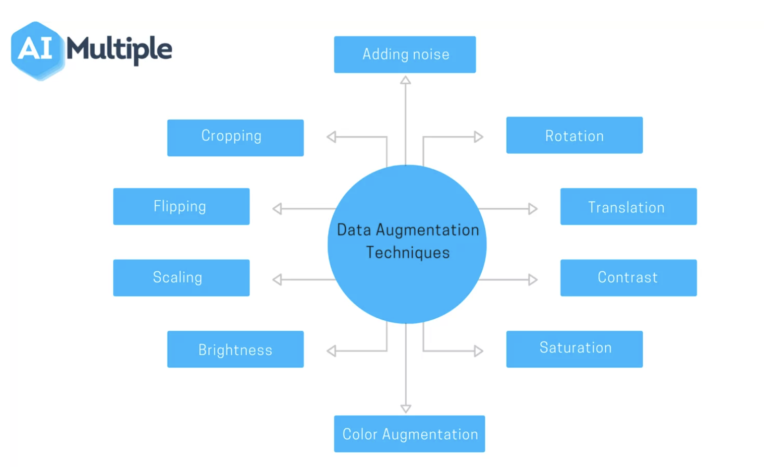
Data Augmentations
Biased crop
Zoom
Flips
Gaussian Noise
Gaussian Blur
Brightness
Contrast

Slide 7
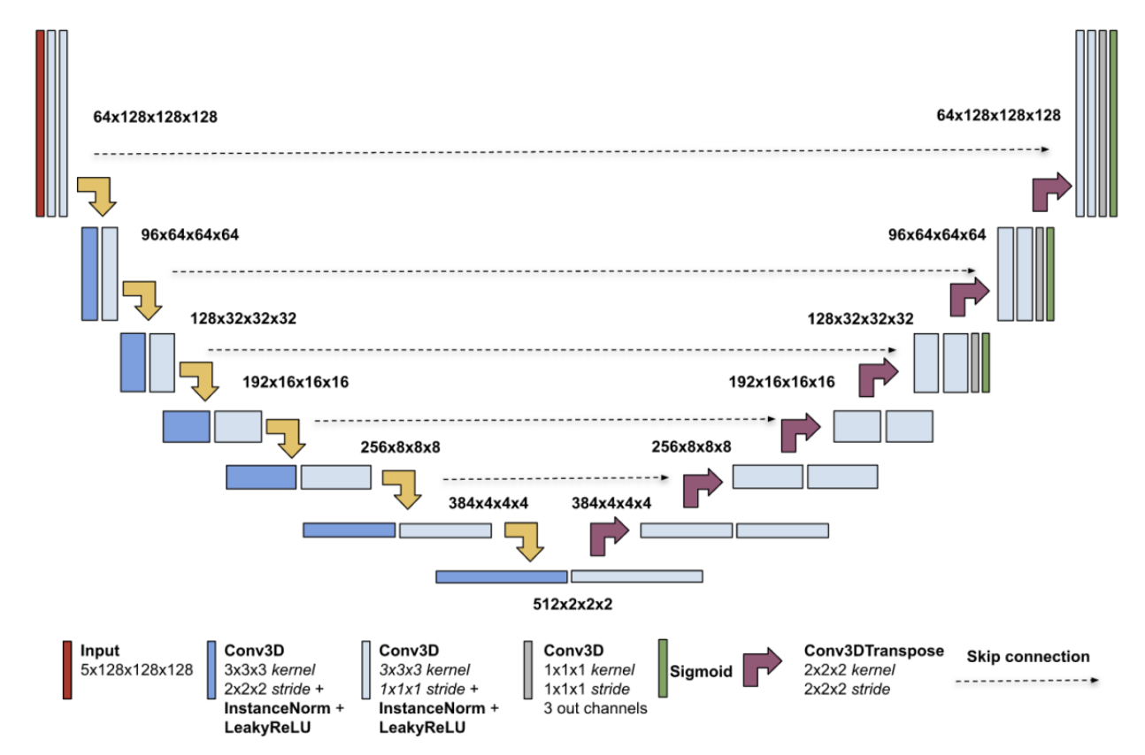
Models Architecture
U-Net

Slide 8
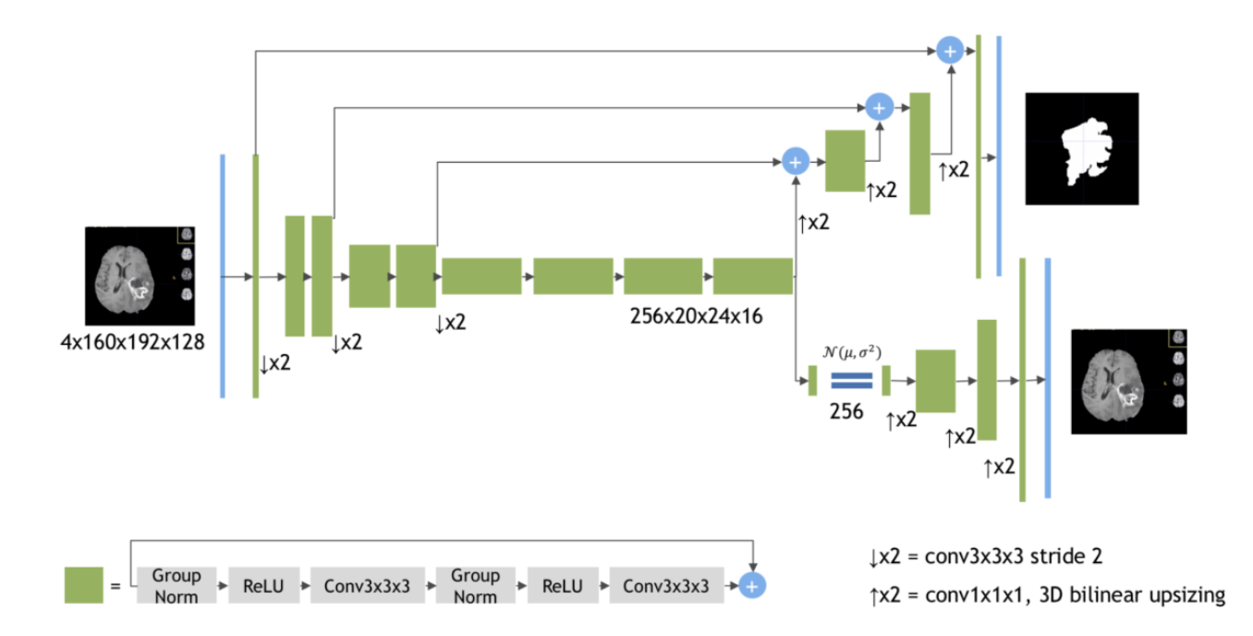
SegResNetVAE

Slide 9
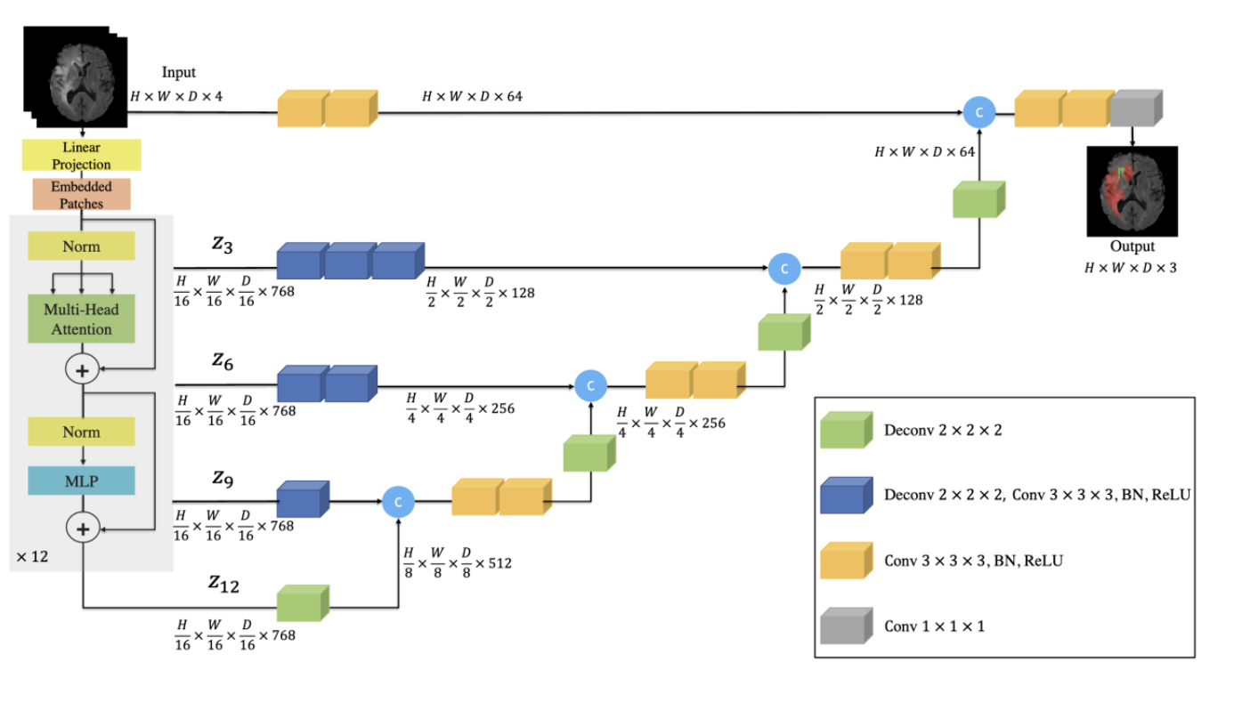
UNETR

Slide 10
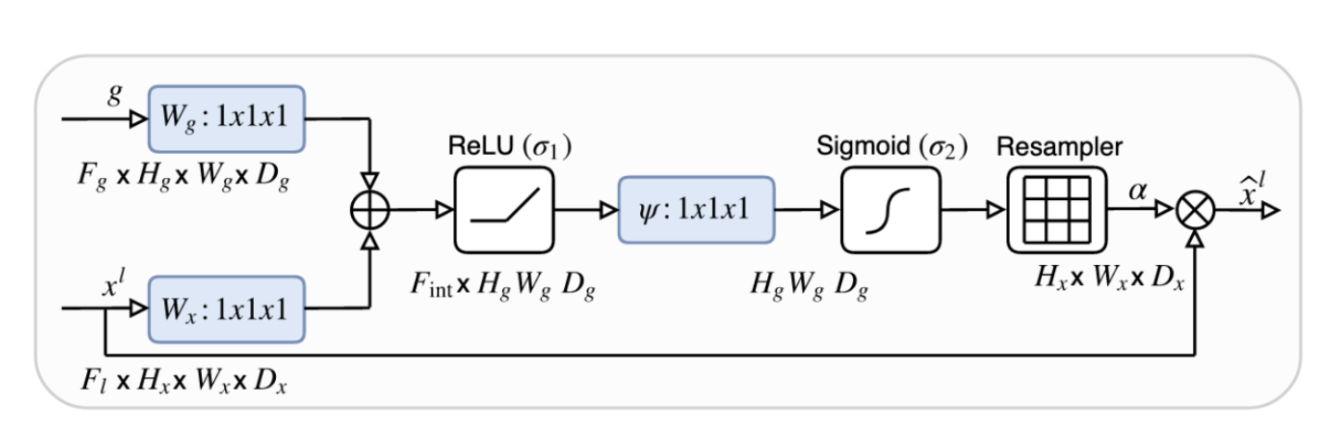
Attention U-Net

Slide 11
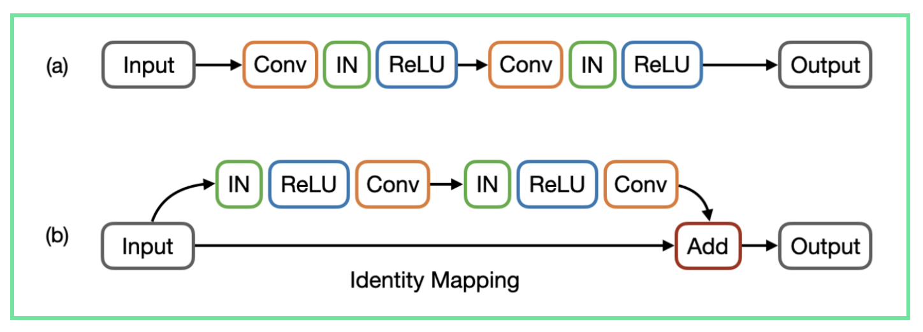
Residual U-Net

Slide 12
Loss function
All the 3 classes were converted into 3 partially overlapping regions: tumor core (TC) representing classes 1, 4, enhancing tumor (ET) representing the class 4 and whole tumor (WT) representing classes 1, 2, 4.
The loss function is designed based on classes which are used for ranking calculation. The output feature map comprises of three channels (one per class) which is then transformed via the sigmoid activation at the end.

Slide 13
Deep supervision and Inference
Deep Supervision is a design technique where different resolution levels are used to generate numerous segmentation maps.
Test time augmentations was used to increase the strength of predictions.
The following scheme was used to convert classes back to original: if WT probability < 0.45 then class =0, TC probability < 0.4 then class = 2(ED), ET probability < 0.45 voxel has class = 1 (NCR), otherwise 4.
Sliding window inference was used where size of window is equal to training patch, i.e., (128, 128, 128) and the overlapping of adjacent windows was half the size of a patch.

Slide 14
Results
The implementations is present in NVIDIA Deep Learning Examples GitHub repository.
Training schedule uses:
Adam optimizer
Kaiming initialization
5-fold cross validation

Slide 15
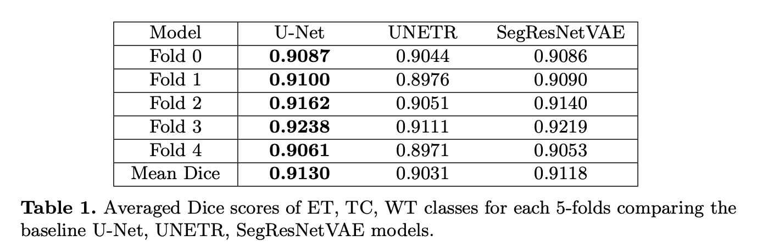
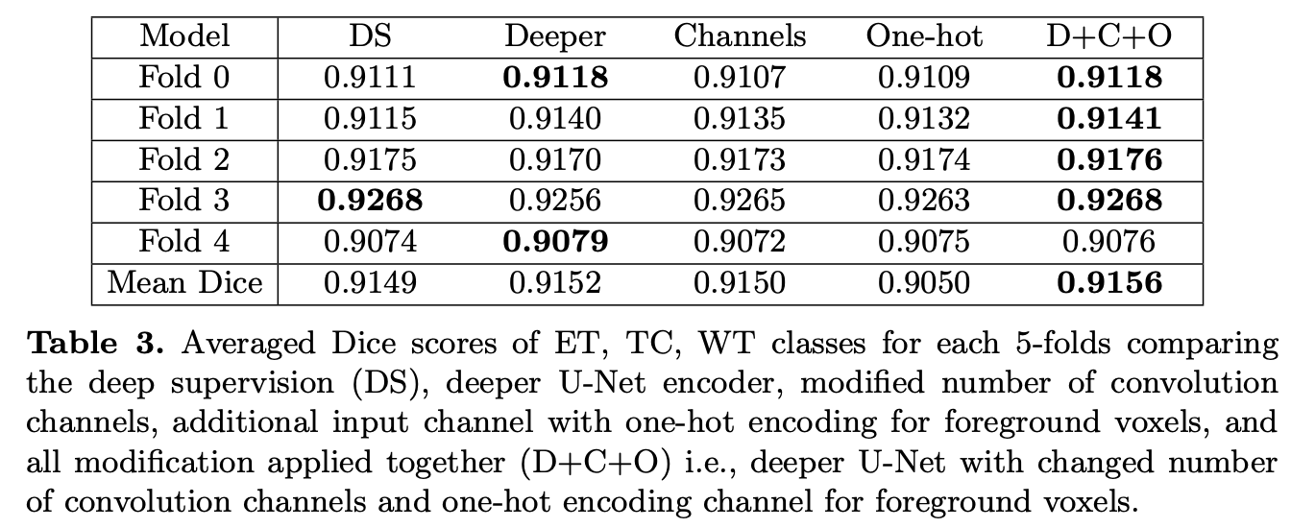
Experiments: Results

Slide 16
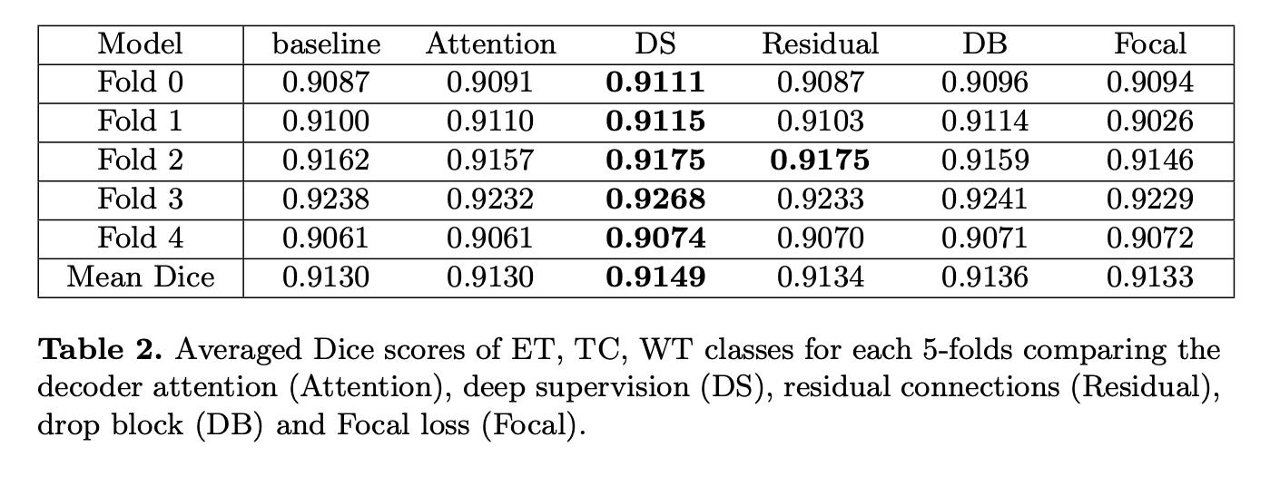
Experiments: Results

Slide 17
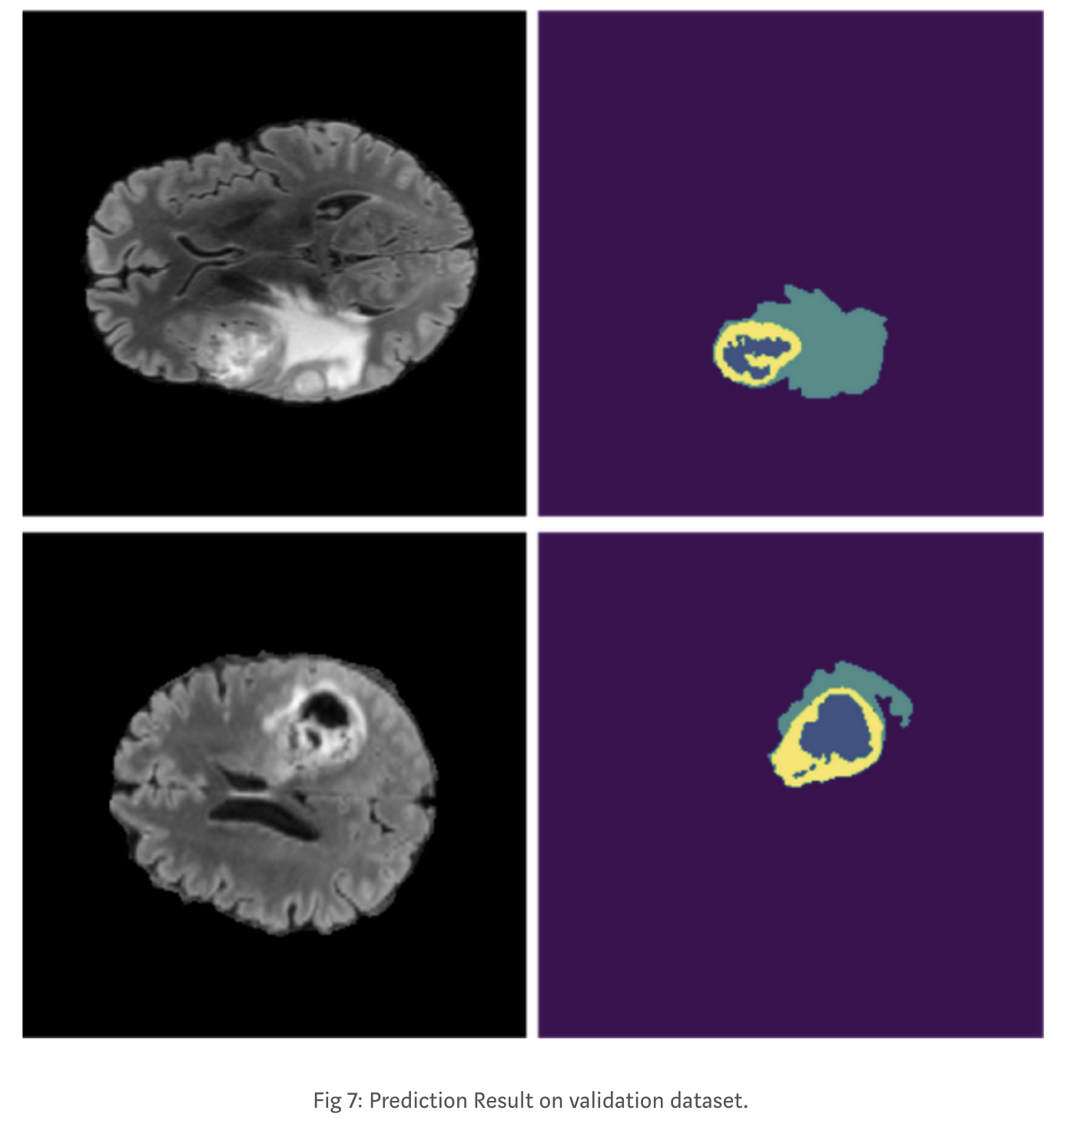
Conclusions
Deep supervision basic U-Net has provided the best results.
It was also observed that basic U-Net result can be further enhanced by:
Increasing encoder depth together with a number of convolutional channels.
Using post-processing strategy.
Additional input channel with one-hot encoding for foreground.

Slide 18
References
https://medium.com/geekculture/understanding-and-analyzing-deep-neural-networks-a2a7ef737511
https://medium.com/@karishma.kuria_14153/optimized-u-net-for-brain-tumor-segmentation-7166681f501c
https://paperswithcode.com/task/brain-tumor-segmentation/latest
https://arxiv.org/pdf/2110.03352v2.pdf
https://research.aimultiple.com/data-augmentation-techniques/
https://miro.medium.com/max/1400/1*BIpRgx5FsEMhr1k2EqBKFg.gif
https://www.templateswise.com/machine-learning-powerpoint-template/

Slide 19
Thank You

